Slide 1
CREDIT-CARD-FRAUD-DETECTION
CAPSTONE PROJECT
Presented By:
ANISH JOVIN A
CARE COLLEGE OF ENGINEERING
MECHANICAL ENGINEERING

Slide 2
OUTLINE
Problem Statement
Proposed System/Solution
System Development Approach
Algorithm & Deployment
Result
Conclusion
Future Scope
References

Slide 3
Problem Statement
The credit card fraud detection problem involves identifying fraudulent transactions made using credit cards. Fraudulent transactions can lead to financial losses for both cardholders and financial institutions, making it crucial to develop effective detection methods.
Given a dataset containing credit card transactions, the task is to develop a machine learning model that can accurately distinguish between legitimate and fraudulent transactions. The model should be able to generalize well to unseen data and provide real-time or near-real-time detection to prevent fraudulent transactions from being processed.

Slide 4
Proposed Solution
Data Collection and Exploration
Data Preprocessing
Feature Engineering
Model Selection
Model Training and Evaluation
Deployment
Continuous Improvement
Regulatory Compliance and Security

Slide 5
System Approach
Data Collection and Preprocessing
Feature Engineering
Data Splitting
Model Evaluation
Model Deployment
Post-Deployment Monitoring
Fraud Investigation and Feedback Loop
Regulatory Compliance
Continuous Improvement

Slide 6
Algorithm & Deployment
Random Forest Algorithm
Hyper parameter Tuning
Data Preparation
Model Serialization
API Development
Integration
Monitoring
Security
Compliance
Feedback Loop

Slide 7
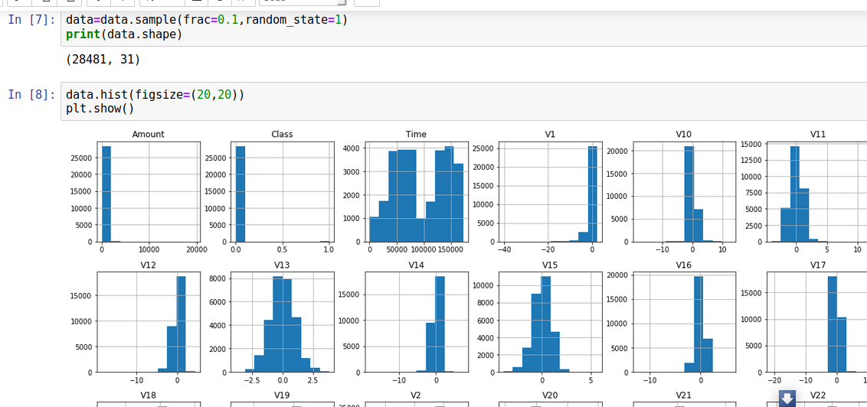
Result
The results of a credit card fraud detection system can vary based on several factors, including the quality of the data, the effectiveness of the algorithm, and the deployment environment
Ideally, a credit card fraud detection system should achieve high precision and recall, indicating that it can accurately identify fraudulent transactions while minimizing false positives and negatives. However, achieving a balance between these metrics is often challenging due to the imbalanced nature of fraud detection datasets.

Slide 8
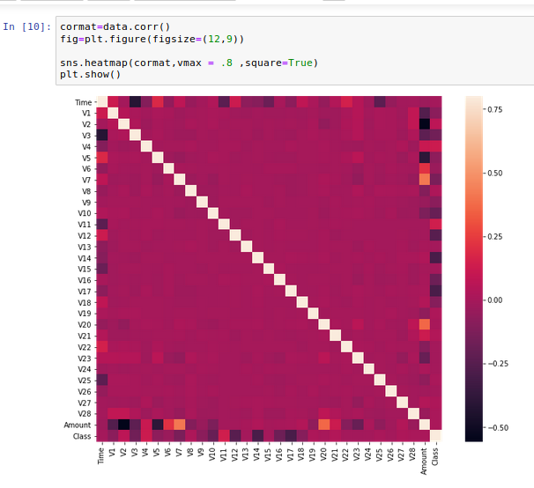
Conclusion
In conclusion, credit card fraud detection is a critical task for financial institutions and consumers alike. A robust fraud detection system can help prevent financial losses, protect cardholders' assets, and maintain trust in the payment ecosystem
Approach
Algorithm
Deployment
Results
Outcomes
In summary, a well-designed and implemented credit card fraud detection system can significantly mitigate the risks associated with fraudulent transactions, protect both financial institutions and consumers, and uphold the integrity of the payment ecosystem.

Slide 9
Future scope
The future of credit card fraud detection holds promising opportunities for advancement and innovation
Advanced Machine Learning Techniques
Anomaly Detection
Behavioral Biometrics
Real-Time Monitoring
Graph Analytics
Explainable AI
Adversarial Defense Mechanisms
Regulatory Compliance
the future of credit card fraud detection lies in leveraging advanced technologies, fostering collaboration, and prioritizing security and transparency to stay ahead of evolving fraud threats and protect the integrity of the financial ecosystem.

Slide 10
References
https://www.irjet.net/archives/V5/i11/IRJET-V5I11304.pdf
https://acadpubl.eu/jsi/2018-118-7-9/articles/7/31.pdf
https://arxiv.org/pdf/1811.02196.pdf
https://towardsdatascience.com/anomaly-detection-with-isolation-forest-visualization-23cd75c281e2

Slide 11
THANK YOU

